Slide 1
Array and String

Slide 2
Arrays
is a collection of similar data items stored at contiguous memory locations and elements can be accessed randomly using indices of an array.
used to store collection of primitive data types such as int, float, double, char, etc of any particular type.

Slide 3
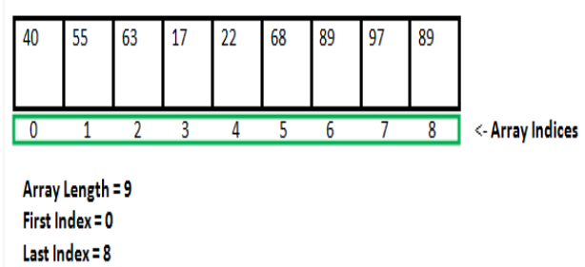

Slide 4
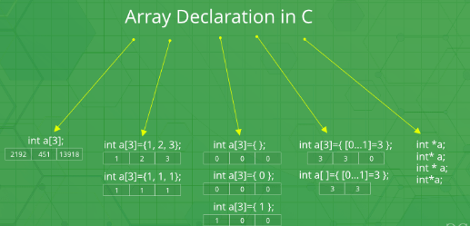

Slide 5
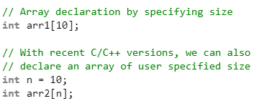
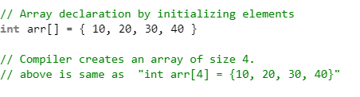
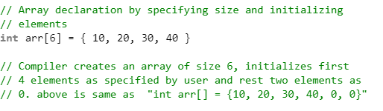

Slide 6
Advantages of an Array in C:
Random access of elements using array index.
Use of less line of code as it creates a single array of multiple elements.
Easy access to all the elements.
Traversal through the array becomes easy using a single loop.
Sorting becomes easy as it can be accomplished by writing less line of code.

Slide 7
Disadvantages of an Array in C:
Allows a fixed number of elements to be entered which is decided at the time of declaration. Unlike a linked list, an array in C is not dynamic.
Insertion and deletion of elements can be costly since the elements are needed to be managed in accordance with the new memory allocation.

Slide 8
Accessing Array Elements: Array elements are accessed by using an integer index. Array index starts with 0 and goes till size of array minus 1.
Name of the array is also a pointer to the first element of array.

Slide 9
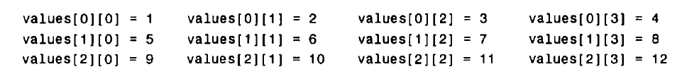
Two Dimensional Array
float table[50][50];
char page[24][80];
int values[3][4] = (1, 2, 3, 4, 5, 6, 7, 8, 9, 10, 11, 12);

Slide 10
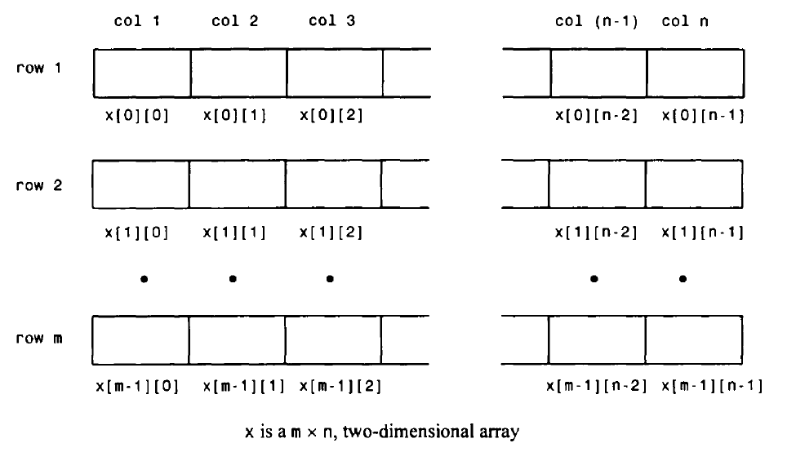

Slide 11
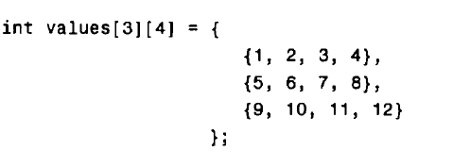
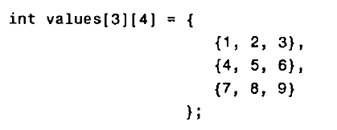
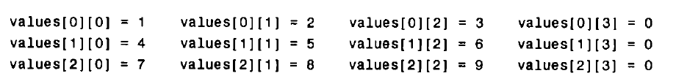

Slide 12
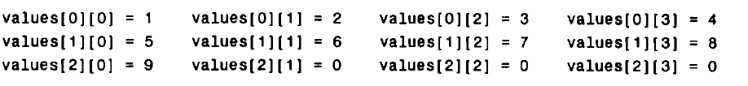
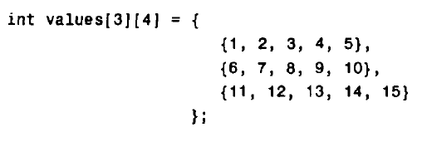
This will result in a compilation error, since the number of values in each inner pair of braces (five values in each pair) exceeds the defined array size (four elements in each row).

Slide 13
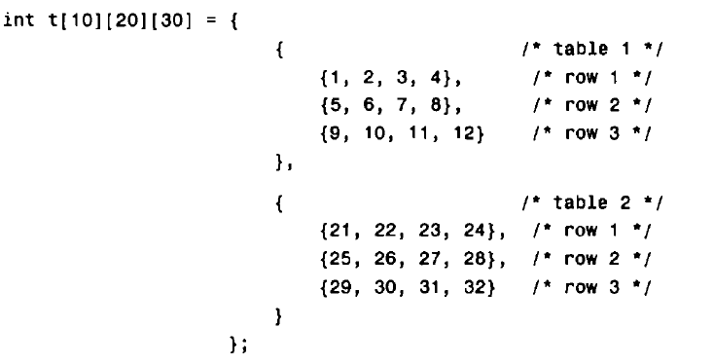
Consider the following three-dimensional array definition.
The following array as a collection of 10 tables, each having 20 rows and 30 columns.

Slide 14
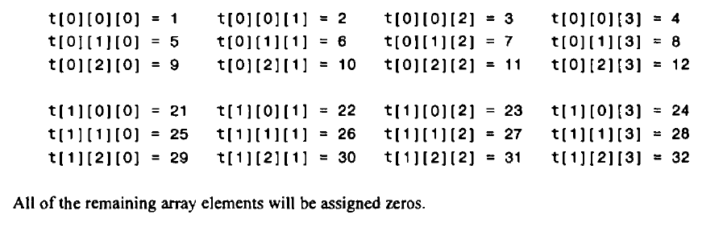

Slide 15
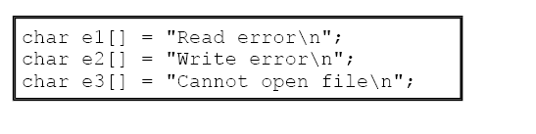
Unsized array
Given these initializations, this statement
printf("%s has length %d\n", e2, sizeof e2)
will print
Write error has length 13

Slide 16
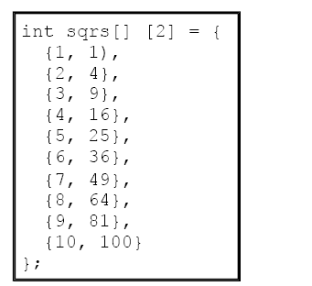
The advantage of this declaration over the sized version is that you may lengthen or shorten the table without changing the array dimensions.

Slide 17
C program to do matrix addition, subtraction and multiplication

Slide 18
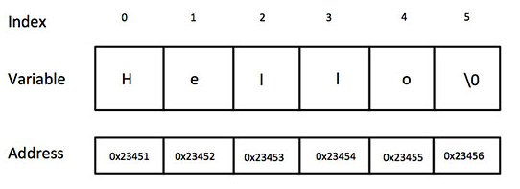
Strings
Strings are actually one-dimensional array of characters terminated by a null character '\0'. Thus a null-terminated string contains the characters that comprise the string followed by a null.
char greeting[6] = {'H', 'e', 'l', 'l', 'o', '\0'};
char greeting[] = "Hello";

Slide 19
The difference between a character array and a string is the string is terminated with a special character ‘\0’.

Slide 20
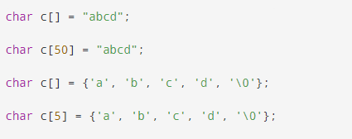
Initialize strings in a number of ways.
char c[5] = "abcde";
Here, we are trying to assign 6 characters (the last character is '\0') to a char array having 5 characters. This is bad and you should never do this.

Slide 21
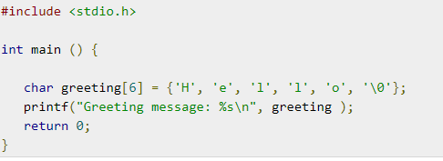
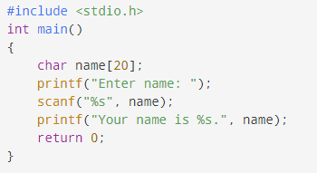

Slide 22
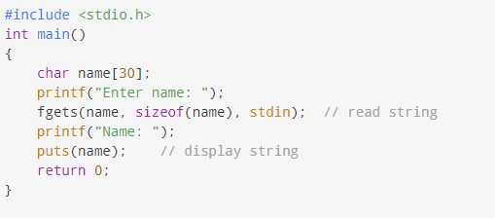
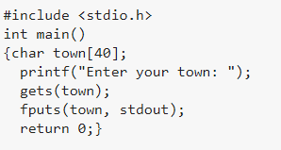

Slide 23
String Library functions <string.h>
Sr.No. | Function & Purpose
1 | strcpy(s1, s2); Copies string s2 into string s1.
2 | strcat(s1, s2); Concatenates string s2 onto the end of string s1.
3 | strlen(s1); Returns the length of string s1.
4 | strcmp(s1, s2); Returns 0 if s1 and s2 are the same; less than 0 if s1<s2; greater than 0 if s1>s2.
5 | strchr(s1, ch); Returns a pointer to the first occurrence of character ch in string s1.
6 | strstr(s1, s2); Returns a pointer to the first occurrence of string s2 in string s1.

Slide 24
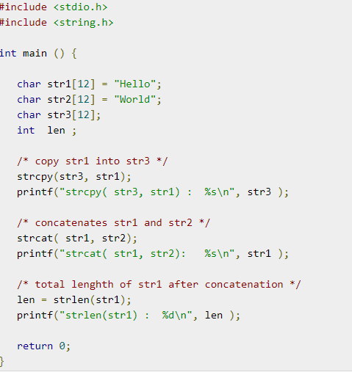

Slide 25
Other Library functions
strncmp(str1, str2, n) :it returns 0 if the first n characters of str1 is equal to the first n characters of str2, less than 0 if str1 < str2, and greater than 0 if str1 > str2.
strncpy(str1, str2, n) This function is used to copy a string from another string. Copies the first n characters of str2 to str1
strchr(str1, c): it returns a pointer to the first occurrence of char c in str1, or NULL if character not found.
strrchr(str1, c): it searches str1 in reverse and returns a pointer to the position of char c in str1, or NULL if character not found.
strstr(str1, str2): it returns a pointer to the first occurrence of str2 in str1, or NULL if str2 not found.
strncat(str1, str2, n) Appends (concatenates) first n characters of str2 to the end of str1 and returns a pointer to str1.
strlwr() :to convert string to lower case
strupr() :to convert string to upper case
strrev() : to reverse string

Slide 26
Converting a String to a Number <stdio.h>
int atoi(str) Stands for ASCII to integer; it converts str to the equivalent int value. 0 is returned if the first character is not a number or no numbers are encountered.
double atof(str) Stands for ASCII to float, it converts str to the equivalent double value. 0 is returned if the first character is not a number or no numbers are encountered.
long int atol(str) Stands for ASCII to long int, Converts str to the equivalent long integer value. 0 is returned if the first character is not a number or no numbers are encountered.

Slide 27
